Slide 1

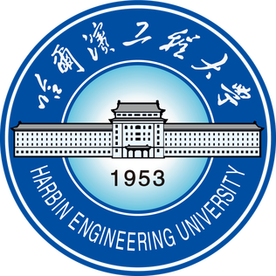
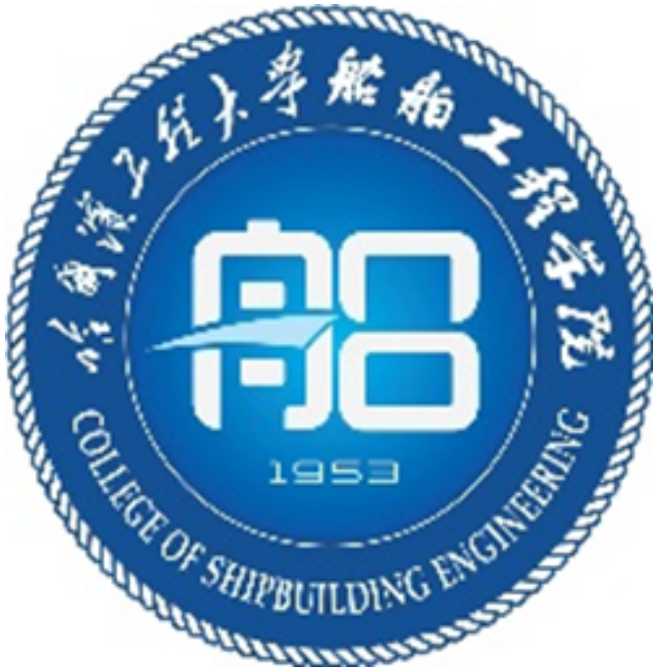
Harbin Engineering University (HEU)
Largest university in China in higher education and scientific research in the areas of Shipbuilding Industry, Marine Equipment, Ocean Exploration, and Nuclear Energy Application.
College of Shipbuilding Engineering
9 research groups and 109 full-time members
3 academic subjects: Naval Architecture and Ocean Engineering, Ports & Waterways, Ocean Robotics (first one in China)
1200+ undergraduates, 600+ Master students and 280+ PhD students
Naval Architecture and Ocean Engineering scored rated “A+” by Ministry of Education.
Rated 2nd in the world for Marine/Ocean Engineering by Shanghai Ranking 2022.

Slide 2

JOIN US
We offer services, sources and development programs to build excellence of your career at College of Shipbuilding Engineering of Harbin Engineering University!
WeChat QR Code
Contact: Mr Pan (潘老师)
E-mail: panfeng@hrbeu.edu.cn
WeChat: heupan

